Slide 1
Reminder
Week 11 (next week) second assessment
Dtae/time: Thursday (2 November), 10:30-11:30.
Venue: LT2a and LT26
LT2a (our normal lecture room): the last digit of your matric number is even, e.g., U172XXX0C, N170XXX6A etc.
LT26 (Block SS4 SS4-B2-33): the last digital of your matric number is odd, e.g. U172XXX1D, U171XXX9A etc.
Topics covered: Proof techniques, Combinatorics, Set Theory, Linear Recurrences

Slide 2
Graph Theory
Part I/III

Slide 3
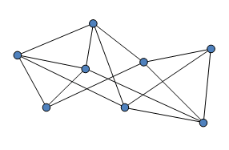
Outline
Definitions
Vertex, edge, adjacent, incident
Simple graph, multigraph, directed (multi)graph
Subgraph
Euler path and Euler Theorem.

Slide 4
Definitions
A graph G = (V,E) is a structure consisting of a set V of vertices (nodes) and a set E of edges (lines joining vertices).
G
e={u,v}
u
v
Two vertices u and v are adjacent in G if {u,v} is an edge of G.
If e = {u,v}, the edge e is called incident with the vertices u and v.
Graphs are useful to represent data.

Slide 5
Subgraphs
A graph H=(V_{H},E_{H}) is a subgraph of G=(V_{G},E_{G}) is V_{H} is a subset of V_{G} and E_{H} is a subset of E_{G}.
v₁ v₂
e₁
Example:
V_{H}={v₁ , v₂ , v₅ } is a subset of V_{G}
E_{H}={e₁ , e₂ , e₃ } is a subset of E_{G}
e₂
e₃
e₄
e₅
v₅
e₆
v₃ v₄

Slide 6
Simple Graphs
A simple graph is a graph that has no loop (=edge {u,v} with u=v) and no parallel edges between any pair of vertices.
London
Beijing
From\To | Hong Kong | Singapore | Beijing | Taipei | London
Hong Kong |  | 4 Flights
Singapore | 2 Flights |  | 3 Flights | 1 Flight | 1 Flight
Beijing | 1 Flight | 2 Flights
Taipei
London |  | 1 Flight | 1 Flight |  | 1 Flight
Hong Kong
Taipei
Singapore
Draw a graph to see whether there are direct flights between any two cities (in either direction)

Slide 7
Multigraphs
A multigraph is a graph that has no loop and at least 2 parallel edges between some pair of vertices.
London
Beijing
From\To | Hong Kong | Singapore | Beijing | Taipei | London
Hong Kong |  | 4 Flights
Singapore | 2 Flights |  | 3 Flights | 1 Flight | 1 Flight
Beijing | 1 Flight | 2 Flights
Taipei
London |  | 1 Flight | 1 Flight |  | 1 Flight
Hong Kong
Taipei
Singapore
Draw a graph with an edge for each flight that operates between two cities (in either direction).
5/12

Slide 8
Directed (Multi)graphs
A directed graph is a graph where edges {u,v} are ordered, that is, edges have a direction. Parallel edges are allowed in directed multigraphs. Loops are allowed for both.
From\To | Hong Kong | Singapore | Beijing | Taipei | London
Hong Kong |  | 4 Flights
Singapore | 2 Flights |  | 3 Flights | 1 Flight | 1 Flight
Beijing | 1 Flight | 2 Flights
Taipei
London |  | 1 Flight | 1 Flight |  | 1 Flight
London
Beijing
Hong Kong
Taipei
Draw a graph to see whether there are direct flights between any two cities (direction matters)
Singapore

Slide 9
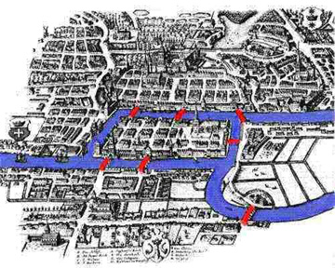
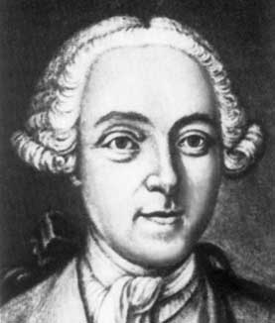
Origin: The Bridges of Konigsberg
a
Königsberg (now Kaliningrad, Russia) has 7 bridges.
People tried (without success) to find a way to walk all 7 bridges without crossing a bridge twice.
1
2
3
7
d
b
6
4
5
c
a
Leonhard Euler introduced Graphs in 1736 to solve the Königsberg Bridge problem (no solution and why).
b
d
c
Notes:
Describe a walk

Slide 10
Euler Path and Circuit
A Euler path (Eulerian trail) is a walk on the edges of a graph which uses each edge in the original graph exactly once.
The beginning and end of the walk may or not be the same vertex.
A Euler circuit (Eulerian cycle) is a walk on the edges of a graph which starts and ends at the same vertex, and uses each edge in the original graph exactly once.

Slide 11
Euler Circuit
Suppose the beginning and end are the same node u.
The graph must be connected.
At every vertex v≠ u, we reach v along one edge and go out along another, thus the number of edges incident at v (called the degree of v) is even.
The node u is visited once the first time we leave, and once the last time we arrive, and possibly in between (back and forth), thus the degree of u is even.
Since the Königsberg Bridges graph has odd degrees, no solution!
a
b
d
c
9/12
Notes:
Describe connected

Slide 12
Euler Theorem
The degree of a vertex is the number of edges incident with it.
Theorem. Consider a connected graph G.
If G contains an Euler path that starts and ends at the same node, then all nodes of G have an even degree.
If G contains an Euler path, then exactly two nodes of G have an odd degree.
Suppose G as an Euler path, which starts at v and finishes at w.
Add the edge {v,w}.
Then by the first part of the theorem, all nodes have even degree, but for v and w which have odd degrees.
Notes:
Multigraph, no loops

Slide 13
Examples
Note: Euler Theorem actually states an if and only if.

Slide 14
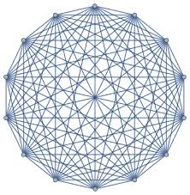
Summary
Graph theory has numerous applications:
E.g., networks, distributed systems, coding theory, …
Definitions
Vertex, edge, adjacent, incident
Simple graph, multigraph, directed (multi)graph
Subgraph
Euler path and Euler Theorem.

